Slide 3
SECTION I
Labor market

Slide 4
Hiring cools, yet labor shortages persist
Vacancy ratios ease while firms continue to report insufficient staff
Fewer vacancies coexist with persistent staffing shortages
Job openings per applicant (SA)
Sources: MHLW Hello Work and BoJ Tankan, July and June 2026. Negative DI indicates insufficient staff
Labor market
Economic activity
Inflation
Fiscal scenario
External sector
Monetary policy

Slide 5
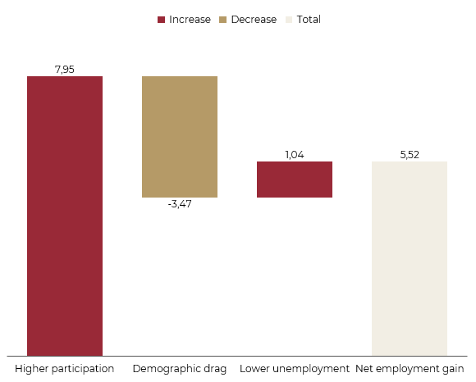
Higher participation has offset demographic pressure
Employment growth has relied on bringing more people into the labor force
Participation more than offsets the demographic drag
Participation gains vary by age
Employment growth contributions (million, Q2 2013 to Q2 2026)
Female labor force participation by age (%)
Further gains depend on removing barriers to work. High participation alone does not imply a ceiling
Source: Labour Force Survey. Shapley decomposition, Q2 2013 to Q2 2026. *Employment as a share of the labor force. Accounting contributions
Labor market
Economic activity
Inflation
Fiscal scenario
External sector
Monetary policy

Slide 6
Labor shortages remain concentrated in specific jobs
Sector and occupation matter when assessing the remaining supply of workers
Hiring constraints vary across sectors and employment types
Specialist shortages exceed clerical gaps
Establishments reporting staff shortages (%)
Staff shortages by occupation (%)
Clerical
Specialists and technicians
Regular roles face broader staffing shortages
Reported shortages reach 50% for regular and similar staff, versus 28% for part-time workers
Transport (62%) and health and social work (59%) face particularly widespread shortages of regular staff
These pressures may sustain wage growth even as hiring cools
Source: MHLW Labour Economy Trend, August 2026. Shares reporting shortages. Employment status and occupation are distinct cuts
Labor market
Economic activity
Inflation
Fiscal scenario
External sector
Monetary policy

Slide 7
The common sample shows more moderate base pay growth
Negotiated increases need to translate into wages actually paid
Common establishments show a smaller, sustained pay increase
Base-up isolates increases in pay scales
Base pay growth by survey sample (% YoY)
Shunto wage settlements in 2026 (%)
Sources: MHLW MLS, July final data, and Rengo 2026 final results. Identified base-up covers a subset of unions
Labor market
Economic activity
Inflation
Fiscal scenario
External sector
Monetary policy

Slide 8
Firms respond with recruitment as well as pay rises
Wage increases are one part of a broader response to staff shortages
Recruitment leads the response, alongside pay and efficiency measures
Measures taken to address labor shortages (% of responding establishments)
Wages
Recruitment
Work organization
Source: MHLW Labour Economy Trend. Measures implemented in Q2 2026 among establishments taking action. Multiple responses
Labor market
Economic activity
Inflation
Fiscal scenario
External sector
Monetary policy

Slide 9
Real wage gains have yet to deliver stronger consumption
Average pay is recovering purchasing power while household spending remains weak
Regular pay gains trail the rise in total earnings
Household spending has yet to follow real wage gains
Real earnings growth (% YoY)
Real disposable income and consumption (% YoY, 3MMA)
Sources: MLS and FIES. FIES covers workers households with 2+ persons. 3MMA is the three-month average of annual growth rates
Labor market
Economic activity
Inflation
Fiscal scenario
External sector
Monetary policy

Slide 10
Labor-intensive services are not driving price acceleration
Wages
Price acceleration is stronger in less labor-intensive services
Services producer prices by labor cost intensity (% YoY)
Staff shortages sustain pressure for pay rises
Wage growth coexists with uneven inflation across business services
Watch the breadth of pay increases and growth in regular earnings.
Income and consumption
Real wage gains have yet to lift spending
Watch for sustained growth in real disposable income and spending
Service prices
Price pressures differ across several services
Look for broader price pressure and confirmation in consumer services
Source: BoJ SPPI, 28 September 2026. August preliminary. Business-to-business services, revised history
Labor market
Economic activity
Inflation
Fiscal scenario
External sector
Monetary policy

Slide 11
SECTION II
Economic activity

Slide 12
Growth is uneven, yet the economy runs above capacity
Quarterly GDP swings between gains and losses while the output gap has stayed positive since 2022
Quarterly growth alternates between gains and setbacks
The output gap stayed positive, with both labor and capital contributing
Real GDP growth (q/q, %)
Output gap and its components (% of potential GDP)
Source: BoJ, Cabinet Office
Labor market
Economic activity
Inflation
Fiscal scenario
External sector
Monetary policy

Slide 13
Growth is modest and volatile, and wages were left behind
Growth swings between shocks and brief rebounds while real wages lag productivity
Growth swings between crises and short-lived rebounds
Real wages have lagged productivity
Real GDP variation (%)
Wage-to-productivity ratio, G7 (1996 = 1)
Sources: OCDE, Cabinet Office

Slide 14
Consumption is steady, but trade drives the swings
In Q2 2026 growth came from lower imports while domestic demand subtracted
Net exports and inventories explain the quarterly swings
Lower imports carried growth in Q2 2026
Contribution to real GDP growth by component (p.p)
Q2 2026 contributions to real GDP growth (p.p.)
Source: Cabinet Office
Labor market
Economic activity
Inflation
Fiscal scenario
External sector
Monetary policy

Slide 15
Prices drive nominal GDP growth
Modest real growth contrasts with a strong GDP deflator, supported by falling import prices
The GDP deflator accounts for most nominal growth
Falling import prices lift the GDP deflator above domestic prices
Real GDP growth and GDP deflator (%, YoY)
Deflators by expenditure component, FY2025 (%, YoY)
Source: Cabinet Office
Labor market
Economic activity
Inflation
Fiscal scenario
External sector
Monetary policy

Slide 16
Activity gains momentum as manufacturing confidence strengthens
Leading indicators recovered from 2025 lows and large manufacturers’ sentiment keeps improving
Activity indexes point to a broad upturn
Manufacturers' sentiment improved for six straight quarters
Indexes of Business Conditions, composite indexes (2020 = 100)
Tankan business conditions DI
Source: BoJ, Cabinet office, Tankan
Labor market
Economic activity
Inflation
Fiscal scenario
External sector
Monetary policy

Slide 17
Labor shortage leave the investment to large firms
Small firms face the tightest labor market and plan the weakest investment growth
Labor is scarce, and affecting small firms the hardest
Capex plans accelerate at large firms and stall at small ones
Tankan employment DI, all industries (excessive – insufficient, %)
Software, R&D and fixed investment excl. land (YoY, %)
+24 manufacturing DI versus +35 non-manufacturing DI. The non-manufacturing DI eased from +37 in June
Labor shortages remain across all firm sizes. Negative employment DI means insufficient staff.
Source: BoJ, Tankan
Labor market
Economic activity
Inflation
Fiscal scenario
External sector
Monetary policy

Slide 18
SECTION III
Inflation

Slide 19
At target, but not everywhere
Headline sits at the target while the typical item in the basket lags well behind
Headline falls back to target after nearly four years above it
The typical price still runs well below target
Headline CPI vs. CPI (ex. food and energy) x target (%)
Inflation trimmed mean vs. weighted median vs. target (%)
Food and energy spike
Sources: Bloomberg; BoJ
Labor market
Economic activity
Inflation
Fiscal scenario
External sector
Monetary policy

Slide 20
A narrow rise, carried by food
Goods and food pushed the index while services lagged
Goods and food sit above the target, the domestic side lags
Rice was the engine of the food spike
CPI per category (%)
Headline CPI vs. food vs. rice (YoY, %)
Scarce supply, after decades of acreage control and a poor 2023 harvest, made rice spike; reserve releases and a larger 2026 crop are now pushing prices down
Rice added 0.47 p.p. to 2025's 3,2% headline, about 15% of inflation from under 1% of the basket; today it is subtracting 0.15 p.p.
Sources: Statistics Bureau of Japan, BoJ
Labor market
Economic activity
Inflation
Fiscal scenario
External sector
Monetary policy

Slide 21
Firms no longer freeze prices
Breadth is easing from its peak, but the old habit of leaving prices untouched has not returned
Most items still rise, even as inflation cools
Share of Increasing items vs. decreasing items (%; simple countage)
1
Snap-back
Every breadth episode unwound within months
2
No freeze
Firms stopped leaving prices untouched, for the first time
3
Fading
Incidence is retreating while wage-setting stays
Bottom line
Behaviour changed, the inflation rate did not. The BoJ is normalising on an unproven regime shift
Source: BoJ
Labor market
Economic activity
Inflation
Fiscal scenario
External sector
Monetary policy

Slide 22
The cost push is back, and it is reaching consumers
Global prices lead the import surge and energy and goods are starting to follow
Global prices lead, the yen amplifies
Energy reacts first, goods follow
Import prices variation vs FX variation (YoY, %)
CPI energy vs CPI good ex. fresh food (YoY, %)
Sources: Bloomberg, E-stat
Labor market
Economic activity
Inflation
Fiscal scenario
External sector
Monetary policy

Slide 23
The shock has not spread, yet
Flexible prices react to every shock; only in 2022 did sticky prices follow
Sticky prices stepped up in 2022, but have not followed a shock since
Sticky inflation (CPI ex. food, energy and institutional factors) vs Flexible inflation (CPI food and CPI energy pondered by weight) vs Target (%)
Sources: BoJ, E-stat
Labor market
Economic activity
Inflation
Fiscal scenario
External sector
Monetary policy

Slide 24
The cost is stuck between firms
Firms charge each other more on wages and oil, but households have not paid for it yet
Firms pass costs to each other, not yet to households
Wages set a durable floor, oil adds a temporary layer
Services (ex. imputed rent) CPI vs SPPI (YoY, %)
SPPI breakdown high labor cost vs low labor cost (YoY, %)
Sources: BoJ, E-stat
Labor market
Economic activity
Inflation
Fiscal scenario
External sector
Monetary policy

Slide 25


Inflation expectations
Sources: BoJ; Reuters
Firms expect inflation above target at every horizon
Understanding the future outlook for Japan’s inflation
News [In] Brief
Tankan inflation projections (all industries, %)
Household inflation expectations hit a record high
A record 90.4% of households expect prices to rise a year ahead, up from 83.7% in March, and 86.1% see prices higher five years out. A former BoJ board member expects import price pressure to reach consumer inflation around autumn to winter
The BoJ Outlook Report already has the pass-through in its baseline
Core CPI to run clearly above 2% from H2 FY26 (with a 2.5% median)
Cost pass-through is moving between firms and set to reach households
Labor market
Economic activity
Inflation
Fiscal scenario
External sector
Monetary policy

Slide 26
SECTION IV
Fiscal scenario

Slide 27
Debt is falling, but not from discipline
Since 2020 Japan has not had a primary surplus, and nominal growth was responsible for the reduction in the debt ratio
Debt has nearly quadrupled as a share of GDP since 1990
General government gross debt (% of GDP)
General government gross debt by instrument (% of total debt)
Nominal GDP growth above the effective interest rate helps reduce debt-to-GDP despite persistent primary deficits.
As maturing debt is refinanced at higher yields, interest costs gradually rise, weakening this favorable dynamic and increasing pressure on the fiscal accounts
Banking crisis
GFC + earthquake
COVID
BoJ QT
Source: IMF, Cabinet Office
Labor market
Economic activity
Inflation
Fiscal scenario
External sector
Monetary policy

Slide 28
Debt is falling, but not from discipliine
Nominal growth and inflation, not primary surpluses, are lowering the debt ratio
Growth above interest offsets primary deficits
GDP outgrows the debt stock
Drivers of the annual change in debt/GDP (pp of GDP)
General government, 2022 = 100
-14.3pp
Change in Debt/GDP, 2021-2024
+13.2pp
Primary deficits, 2021–202424
Source:

Slide 29
Debt is falling, but not from discipline
Nominal growth and inflation, not primary surpluses, are lowering the debt ratio
Growth above interest offsets primary deficits
GDP outgrows the debt stock
Drivers of the annual change in debt/GDP (pp of GDP)
General government, 2022 = 100
-14.3 p.p.
+13.2 p.p.
Change in debt/GDP
(2021-2024)
Primary deficits
(2021-2024)
Source: BoJ
Labor market
Economic activity
Inflation
Fiscal scenario
External sector
Monetary policy

Slide 30
Private surpluses finance public deficits and overseas lending
The deficit narrowed by about 1 pp of GDP while Japan’s external surplus widened
Private surpluses fund public deficits
Net lending (+) / net borrowing (−) by institutional sector (% of GDP), FY2005–FY2024
Last data
Households and firms earn more than they spend, which covers the deficit and lending
Private surplus 6.0%
1.4%
4.6%
Government
covers the deficit
Rest of the world
lent abroad
Japan lends abroad more than three times what its government borrows
Source: Cabinet Office
Labor market
Economic activity
Inflation
Fiscal scenario
External sector
Monetary policy

Slide 31
Higher yields gradually feed into debt costs
44% of the debt refinances within five years and interest payments triple by FY2035
44% of JGBs mature within five years
Average cost follows the market with a lag
Outstanding ordinary JGBs by remaining maturity (¥ trillion)
10Y yield vs effective rate on public debt (%), growth case 1
9y 5m
average remaining maturity
Interest payments triple by FY2035 (16% to 34% of tax revenue)
Sources: MoF, Cabinet Office
Labor market
Economic activity
Inflation
Fiscal scenario
External sector
Monetary policy

Slide 32
The budget gap is closing from the revenue side
Tax revenue gained 1.9pp of GDP since FY2018 while budgeted outlays stayed flat
Tax revenues catch up with budgeted spending
Corporate and consumption taxes drive revenue gains
General Account (% of GDP): tax revenue vs budgeted outlays
Change FY2018 to FY2025 by item (p.p of GDP)
gap 6.5 p.p.
gap 4.6 p.p.
Source: BoJ
Labor market
Economic activity
Inflation
Fiscal scenario
External sector
Monetary policy

Slide 33
The BoJ is scaling back QE after a decade of buying
BoJ share of JGBs are reducing, banks and public pensions absorb the supply
The BoJ no longer owns half of the JGB market...
...and banks and public pensions are filling the gap
BoJ share of outstanding JGBs (%)
Change in share of outstanding JGBs by holder, Dec 2023 to Jun 2026 (p.p.)
Source: Cabinet Office
Labor market
Economic activity
Inflation
Fiscal scenario
External sector
Monetary policy

Slide 34
Interest bill is starting to grow and could cause problems
Budgeted interest payments up 53% in three years, and are the largest single driver of spending growth
Budgeted interest payments reach ¥13.0tn in FY2026
Interest explains over a third of this year's spending increase
Interest payments, General Account initial budget (¥ trillion)
Change in General Account expenditure by item, FY2026 vs FY2025 initial budget (¥ trillion)
Source: BoJ
Labor market
Economic activity
Inflation
Fiscal scenario
External sector
Monetary policy

Slide 35
SECTION V
External Sector

Slide 36
A long period of trade surplus
Japan has had a significant trade surplus since 1980
Japan faced two structural breaks over the last 36 years
Japan manages to be a creditor to the world
Total exports vs. total imports (M/M, USD bn)
NIIP breakdown (USD bn)
1990
Start of Offshoring
2011
Fukushima Crisis
~60%
of External Assets in US Dollars
1.18T
in American Bonds
The United States is Japan’s greatest credor
Sources: BOJ | Trading Economics
Labor market
Economic activity
Inflation
Fiscal scenario
External sector
Monetary policy

Slide 37
Always in surplus on current account
Primary income sustains this surplus since 2010
A consistently positive checking account balance
Undergoes a process of internationalization of the financial system
Japan current acount breakdown (QoQ, JPY tn)
External debt as % of the PIB
Internationalization of the financial system
Currency devaluation
Economic stabilization
External Debt/GDP
Sources: BOJ | Trading Economics
Labor market
Economic activity
Inflation
Fiscal scenario
External sector
Monetary policy

Slide 38
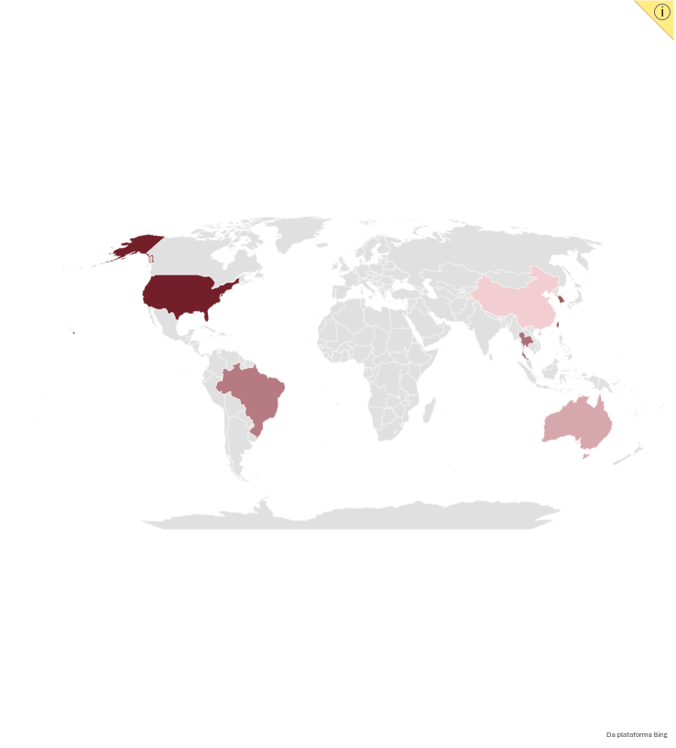
A trade balance narrowing over time
Since 1990, Japan's trade balance has been shrinking and becoming volatile
A large part of the deficit stems from China and Australia
An extremely volatile trade balance
Commercial balance with Japan 6 biggest comercial partners and Brazil in USD Bi
2025 Japan exports and imports breakdown
Exports
Imports
-52,9
49,9
16,4
Trade of terms vs Exchange rate (M/M) - Indexed in 100 at jan/2021
-4,1
19,4
2,7
-30,5
Source: BOJ | Trading Economics
Labor market
Economic activity
Inflation
Fiscal scenario
External sector
Monetary policy

Slide 39
A long period of trade surplus
Japan has had a significant trade surplus since 1980
Japan faced two structural breaks over the last 36 years
Japan manages to be a creditor to the world
Total exports vs. total imports (QoQ, JPY tn)
NIIP breakdown (QoQ, JPY tn)
1990
Start of Offshoring
2011
Fukushima Crisis
~60%
of External Assets in US Dollars
1.18T
in American Bonds
The United States is Japan’s greatest credor
Sources: BOJ | Trading Economics

Slide 40
A long period of trade surplus
Japan has had a significant trade surplus since 1980
Japan faced two structural breaks over the last 36 years
Japan manages to be a creditor to the world
Total exports vs. total imports (QoQ, JPY tn)
NIIP breakdown (QoQ, JPY tn)
1990
Start of Offshoring
2011
Fukushima Crisis
~60%
of External Assets in US Dollars
1.18T
in American Bonds
The United States is Japan’s greatest credor
Sources: BOJ | Trading Economics
Labor market
Economic activity
Inflation
Fiscal scenario
External sector
Monetary policy

Slide 41
Always in surplus on current account
Primary income sustains this surplus since 2010
A consistently positive checking account balance
Foreigners prefer financial investments
Japan current acount breakdown (QoQ, JPY tn)
Breakdown of external liabilities (JPY tn)
Undergoes a process of internationalization of the financial system
External debt breakdown (JPY bn)
Sources: BOJ | Trading Economics

Slide 42
Always in surplus on current account
Primary income sustains this surplus since 2010
A consistently positive checking account balance
Foreigners prefer financial investments
Japan current acount breakdown (QoQ, JPY tn)
Breakdown of external liabilities (JPY tn)
Undergoes a process of internationalization of the financial system
External debt breakdown (JPY bn)
Sources: BOJ | Trading Economics
Labor market
Economic activity
Inflation
Fiscal scenario
External sector
Monetary policy

Slide 43


Carry trade is becoming less possible
The interest rate differential is narrowing, but the carry trade is still viable
The future interest rate differential is minimal
The future exchange rate makes carry trade still viable
JGB vs USA Bonds (%) - (D/D) and 30Y forward
Exchange rate JPN/USD (D/D) and 5Y forward
Why did the exchange rate and the interest rate differential start moving in opposite directions?
Fiscal scenario
Increase in external financial liabilities
Snowball effect
1M
1Y
30Y
Sources: BOJ | Trading Economics | IMF
Labor market
Economic activity
Inflation
Fiscal scenario
External sector
Monetary policy

Slide 44
SECTION VI
Monetary policy

Slide 45








Explaining BoJ
Nine voting members and two non-voting government representatives.
BoJ Rules
BoJ Composition
Current Members
1 Governor
2 Deputy Governor
6 Board Members
Ueda Kazuo, Governor of the Board
Himino Ryozo, Deputy Governor
Uchida Shinichi, Deputy Governor
Takata Hajime, Member
Tamura Naoki, Member
Koeda Junko, Member
Masu Kazuyuki, Member
Sato Ayano, Member
Asada Toichiro, Member
Decisions are made by a majority
In a tie, the Governor have the deciding vote
All 9 members vote
The government has a seat but no vote
Express opinions, submit proposals, and request that a vote be postponed to the next meeting
Indications 5 years
Held every 5 years by the Cabinet (Japan’s executive Branch) and approved by the House of Diet
2 Outside Members
(Cabinet members don't vote)
International Revenue as % of total Revenue (%)
Labor market
Economic activity
Inflation
Fiscal scenario
External sector
Monetary policy

Slide 46



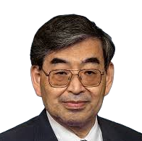

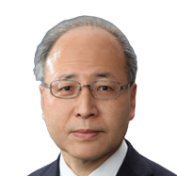
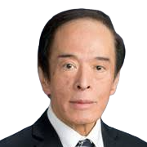





Explaining BoJ
Nine voting members and two non-voting government representatives
Board Hawkometer
BoJ Rules
BoJ Composition
Current Members
Dovish
Hawkish
Ayano Sato
Board Member
1 President
2 Vice-President
6 Board Members
Appointed by the current government
Toichiro Asada
Board Member
Ryozo Himino
Deputy Governor
2 Outside Members
(Gabinet members → don't vote)
Shinichi Uchida
Deputy Governor
Kazuo Ueda
Governor
International Revenue as % of total Revenue (%)
Kazuyuki Masu
Board Member
Junko Koeda
Board Member
Hajime Takata
Board Member
Naoki Tamura
Board Member
Source: Bloomberg Economics hawk-dove positioning, Sep 2026; photos: Bank of Japan
Labor market
Economic activity
Inflation
Fiscal scenario
External sector
Monetary policy

Slide 47
Japan's monetary policy has been normalizing
Policy rates are rising as long-term yields reprice
After years at negative, the interest rate converges toward neutral
Yield curve steepens sharply as market price discovery returns
Japan Interest Rate (%)
Yield of JGBs of 10Y and 30Y (%)
Source: BoJ
Labor market
Economic activity
Inflation
Fiscal scenario
External sector
Monetary policy

Slide 48
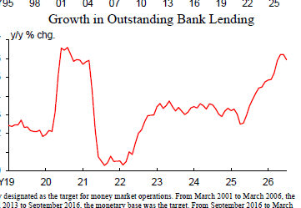
Financial conditions remain accommodative
Interest rate tightening are a movement to adjust monetary accommodation
Real rates are still negative, but closing the gap
Credit keeps accelerating despite rate hikes
BoJ policy rate minus realized 12-month-ahead core core CPI (%)
YoY Outstanding Bank Lending (%) per month
O ideal é usar a projeção do grupo para calcular a taxa de juros real
Source: BoJ
Labor market
Economic activity
Inflation
Fiscal scenario
External sector
Monetary policy

Slide 49
The momentum of the increase generates debates
The rate reached 1.25%, entering the range of the Neutral interest rate estimated by the BoJ
December of 2025 started the hawkish cycle
In September, the BoJ's interest rate entered the northern range
BoJ last meeting analysis
BoJ base rate and nominal neutral range (%)
Date | Rate | Summary
Dec/25 | (+) 25 bps | Hike to 0.75% unanimously
Jan/26 | O bps | Hold at 0.75%. Only Takata dissent, arguing a more hawkish approach
Mar/26 | 0 bps | Hold at 0.75%, 8–1, Takata again for 1.00%
Apr/26 | 0 bps | Hold at 0.75% by 6–3, the widest split of the cycle: J. Nakagawa, Takata and Tamura all proposed 1.00%
Jun/26 | (+) 25 bps | Hike to 1.00%, highest since 1995. Only T. Asada disent, citing risks to production and employment
Jul/26 | 0 bps | 8-1 vote, with H. Takata voting for a 25 bps hike (to 1.25%), advocating agility
Set/26 | (+) 25 bps | The 7–2 vote exposed a dovish split: Asada and Sato, both Takaichi appointees, voted to hold rates at 1%, clouding the outlook for further hikes.
2,5
Neutral Interest rate range
1,1
Source: BoJ

Slide 50
The momentum of the increase generates debates
The rate reached 1.25%, entering the range of the Neutral interest rate estimated by the BoJ
December of 2025 started the hawkish cycle
In September, the BoJ's interest rate entered the northern range
BoJ last meeting analysis
BoJ base rate and nominal neutral range (%)
0.50%
Dec- 25
(+) 25 bps by 9x0
2,5
Jan - 26
Hold by 8x1
Takata dissent for 1.00%
Neutral Interest rate range
Mar - 26
Hold by 8x1
Takata again for 1.00%
Apr - 26
Hold by 6x3
J. Nakagawa, Takata and Tamura dissident for 1.00%
Jun - 26
(+) 25 bps by 8x1
Asada dissent for 0.75%
1,1
Jul - 26
Hold by 8x1
Takata dissent, arguing a more hawkish approach
Set - 26
(+) 25 bps by 7x2
dovish split: Asada and Sato dissenrt for 1.00%, clouding the outlook for further hikes.
1.25%
Source: BoJ
Labor market
Economic activity
Inflation
Fiscal scenario
External sector
Monetary policy

Slide 51
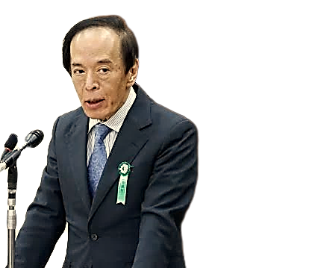

Monetary tightening is priced in, but its timing remains unsettled
The level of momentum of adjustment can generate major economic impacts in Japan
Market is uncertain about the momentum of the hikes
Accelerating too much can disrupt GDP recovery
Daily WIRP-implied hike pricing for the Oct and Dec 2026 BoJ meetings (%)
Ueda warns that sharp rate hikes could also trigger large asset-price adjustments
“ ”
BoJ last meeting
“It's important ​to avoid financial conditions from tightening too much, or to cause a big ​adjustment in asset prices, by raising rates too sharply”
It's important ​to avoid financial conditions from tightening too much, or to cause a big ​adjustment in asset prices, by raising rates too sharply
Ueda Kazuo – Governor of BoJ
A slow pace can keep the yen vulnerable
The expected hike gave little guidance on what comes next
News [In] Brief
Dollar advances vs yen as BOJ dissent clouds rate-hike outlook
The 25 bps hike came with two votes against and no clear sign of further increases. The market began to question the momentum of the cycle, and the dollar rose against iene as much as 1.2% to ¥157.90
Sources: Bloomberg, Reuters
Labor market
Economic activity
Inflation
Fiscal scenario
External sector
Monetary policy

Slide 52





Washington is pressing Japan on monetary policy
US backing for yen intervention comes with an expectation of further policy action from Tokyo
Why does Japan's stability matter to the U.S.?
USD/JPY and 10Y UST Yield (%)
$1.104 trillion U.S. tresuries (largest global holder)
A sharp yen depreciation raises the risk of Japanese Treasury sales to support the currency, putting upward pressure on long-term U.S. yields
A sharp yen rally can trigger carry-trade unwinds and amplify global volatility
USD/YPY and 10Y UST yield (%) in the last 12M
the US is acting actively in Japanese monetary policy
News [In] Brief
“ ”
US Treasury undertakes historic intervention in yen market
The U.S. Treasury Department intervened in the yen's exchange rates market, which had not occurred since 2011. The estimated operation was a purchase of ¥8.45 trillion (US$52.8 billion). Such a move reflects a broad effort by the US to contain the depreciation of the yen
I have asymmetric information. I am the house now. […] And you can bet against me if you want (referring to the yen).
Scott Bessent – Secretary of the US Treasury
Source:s BoJ,, Financial Times
Labor market
Economic activity
Inflation
Fiscal scenario
External sector
Monetary policy

Slide 54
SECTION VII
Appendix

Slide 55
Policy trims inflation, it doesn't explain it
Stripping out government measures lifts core inflation, yet it still runs below target
The gap opens whenever the government cuts prices by decree
Core core CPI vs Core core CPI ex. institutional factors (in %)
Trend
Stripping out policy, core has held near 1.7-1.9% since 2024, the published slowdown is mostly policy, not demand
Policy trims around 0.3pp off measured core
Ahead
Free tuition and school lunches drop out of the YoY from April 2027, lifting measured core, though it still sits below 2%
Source: BoJ

Slide 56
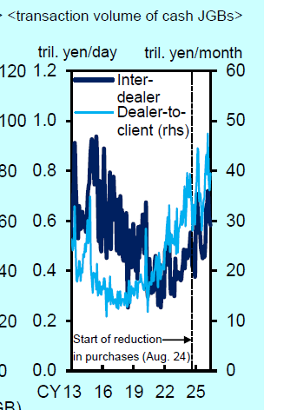
BoJ QT is restoring JGB market functioning
QT is improving market functioning as private investors absorb more bonds
The BoJ's balance sheet is turning after years of expansion
The BoJ's share of the JGB market is falling
BoJ assets by instrument (¥ trillion)
-6,4% of BoJ JGBs share
Quantitative Easing
(QE)
Quantitative Tightening
(QT)
JGB trading activity is recovering
Cash JGB transaction volume (¥tn/month)
QT period
Source: BoJ

Slide 57
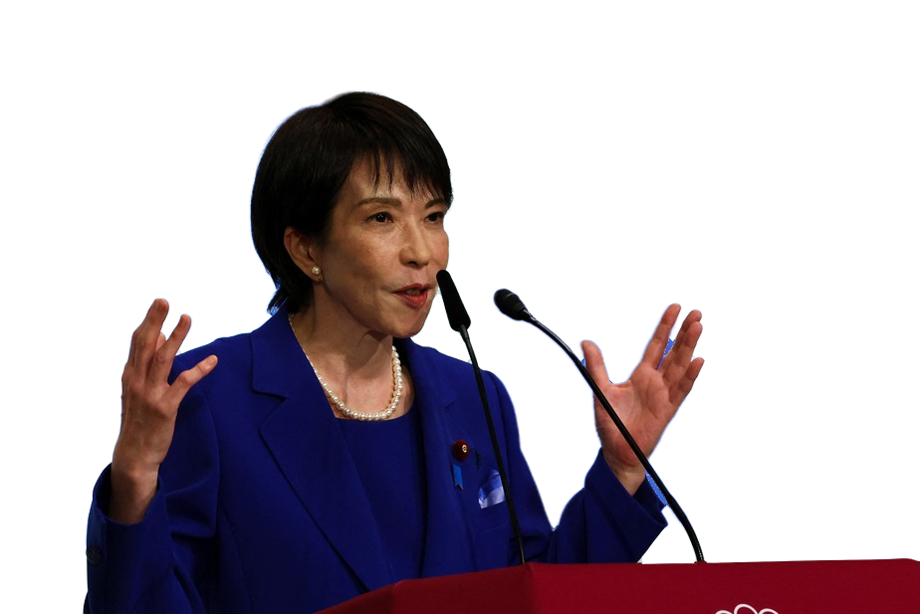
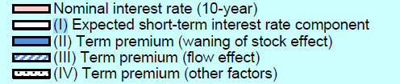
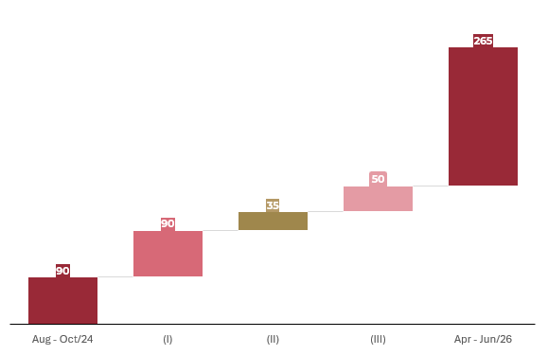
BoJ is slowing QT under political pressure
The Bank keeps market-based pricing intact
Why political pressure is rising
QT has raised yields, but its estimated effect is modest
higher long-term yields raise refinancing costs for a heavily indebted government
Contribution to the 10Y yield increase since Aug-24 (bps)
News [In] Brief
Only 35bps of current long-term interest rates are consequences of the BoJ's QT
BoJ's rate-hike path runs into Takaichi's bond market problems
Fearing the impact of rising yields on public debt, allies of PM Takaichi are openly criticizing the BOJ's bond-tapering strategy. According to domestic media, the prime minister herself urged Governor Kazuo Ueda, at their May meeting, to buy more bonds when necessary to curb rises in long-term rates.
TODO: Colocar legenda no gráfico
Sanae Taikaichi
Prime Minister of Japan
Total 10Y yield increase (Aug–Oct/24; Apr–Jun/26)
(I) Expected short-term interest rate component
(II) Term premium (waning of stock effect)
(III) Term premium (fOther Factors)
Source: BoJ, Reuters

Slide 58
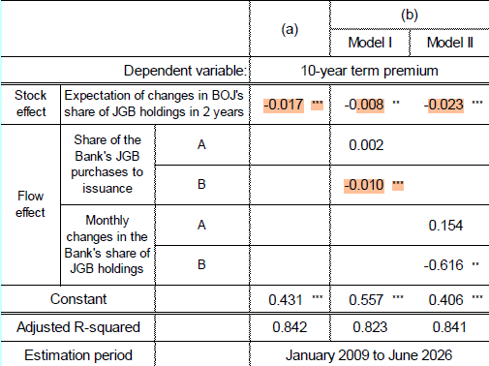


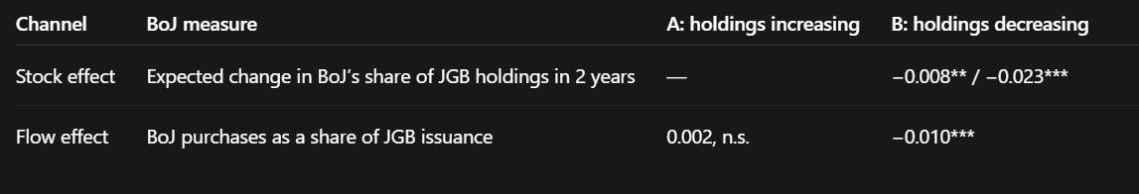
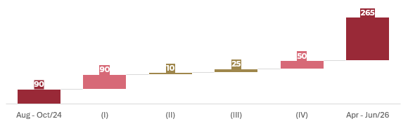
The BoJ estimates a modest QT effect on long-term yields
Stock and flow channels affect the term premium
QT affects long-term yields through two channels
QT explains only a small share of the yield increase
Transmission from JGB purchases to the term premium
10Y yield decomposition since Aug-24 (cumulative change, p.p.)
Stock Effect: As the BoJ's holdings decline, more interest-rate risk remains with private investors, gradually lifting the term premium.
The two added give only 35 bps
Flow Effect: s monthly purchases decline, the BoJ adds less marginal demand to the JGB market, also lifting the term premium.
Total 10Y yield increase
(II) Term premium (waning of stock effect)
(I) Expected short-term interest rate component
(III) Term premium (fOther Factors)
All of this was calculated through the BoJ study
‘
Channel
BoJ measure
A: QE period
B: QT period
Dependent variable: 10-year term premium
Estimation period: January 2009 to June 2026
*** denote statistical significance at the 1%
Stock effect
Expected change in BoJ’s share of
JGB holdings in 2 years
—
−0.023***
Flow effect
BoJ purchases as a share of JGB
issuance
0.002, n.s.
−0.010***
Source: BoJ

Slide 59
Labor reserves extend beyond unemployment
Broader underutilization includes workers seeking more hours and potential entrants
Broader slack exceeds measured unemployment
Available labor includes workers seeking longer hours
Unemployment and broader underutilization (%)
Labor underutilization by component (million)
Want more working hours
Unemployed (broad definition)
Potencial labor force
Source: Statistics Bureau Labour Force Survey via eStat

Slide 60
Working hours qualify the picture of labor supply
Employment status matters for both working time and monthly earnings
Short hours are more common among non-regular workers
Changes in hours also affect monthly pay
Weekly working hours by employment status (%)
Average hours at common establishments (% YoY)
Sources: Statistics Bureau Labour Force Survey via eStat, MHLW

Slide 61
Family circumstances shape participation gaps
Age and care responsibilities help identify barriers to additional labor supply
Participation gaps vary with family circumstances
Care duties constrain part of the potential workforce
Female participation by age and marital status (%)
Barriers among women wanting to work (million)
Source: Statistics Bureau Labour Force Survey via eStat

Slide 62
Participation can partly offset demographic pressure
Population projections and labor force scenarios depend on different assumptions
Aging reduces the population of working age
Higher participation can cushion demographic decline
Projected population by age (million)
Labor force scenarios (million)
Sources: IPSS Population Projections for Japan 2023, JILPT Labour Supply and Demand Estimates 2023

Slide 63
Regional hiring conditions remain uneven
Active openings per applicant in July 2019 and July 2026, ranked by the latest reading
National cooling masks persistent differences across local labor markets
Active job openings per applicant by prefecture (SA)
Source: MHLW Employment Referrals for General Workers
Notes:
A5
Regional hiring conditions remain uneven
Active openings per applicant in July 2019 and July 2026, ranked by the latest reading
A5A
V3 workbook tab: A5A_Vagas_regioes
Range: A11:C58
Chart title: Active job openings per applicant by prefecture (SA)
Callout: National cooling masks persistent differences across local labor markets
Source: MHLW Employment Referrals for General Workers
Definitions and interpretation: Seasonally adjusted active openings per applicant. July 2019 and July 2026. National total excluded. Same geographic definition in both years. All 47 prefectures, ranked by July 2026, with a common axis across the three panels.
Vintage: Local package dated 16 September 2026, not fully refreshed

Slide 64
Smaller firms deliver smaller pay increases
The 2025 survey separates the size of wage increases from their breadth
Larger firms report stronger wage increases
Pay increases are widespread, with gaps by firm size
Wage increases by firm size (%)
Firms raising wages by size (%)
Source: MHLW Survey on Wage Increase 2025

Slide 65
Shunto covers only part of the labor market
Union membership varies by employment status and industry
Limited union membership constrains Shunto coverage
Union presence differs sharply across industries
Trade union membership rates (%)
Trade union membership by industry (%)
Union membership and bargaining coverage differ. Shunto does not directly represent all workers.
Source: MHLW Basic Survey on Labour Unions 2025

Slide 66
The wage sample gap also appears among full-time workers
Base pay growth differs between the headline and common-establishment samples
The common sample also shows weaker growth among full-time workers
Full-time base pay growth by survey sample (% YoY)
Source: MHLW

Slide 67
The wage outcome of a job change varies with age
Worker flows and pay changes help assess the scope for better employment matches
Worker turnover differs by employment status
Younger job changers more often secure pay increases
Hiring and separation rates (%)
Pay changes after switching jobs by age (%)
Source: MHLW Employment Trends Survey 2025

Slide 68
Different margins imply different capacity to absorb pay rises
Corporate accounts show margins and pay per employee by capital size
Higher margins provide more room to absorb pay rises
Pay growth alone cannot establish pressure on margins
Operating margin by capital size (%)
Pay per employee by capital size (Q1 2019 = 100)
Source: MoF Financial Statements Statistics of Corporations

Slide 69
Consumption weakness extends beyond the July reading
Smoothing the monthly data still shows falling real household spending
The three-month average confirms persistent weakness in consumption
Real household income and consumption (% YoY)
Source: Statistics Bureau

Slide 70
Business service prices only capture part of wage transmission
Labor cost intensity helps compare price trends but does not establish causality
Different price trends do not isolate the effect of wages
Services producer prices by labor cost intensity (% YoY)
Source: BoJ

Slide 72
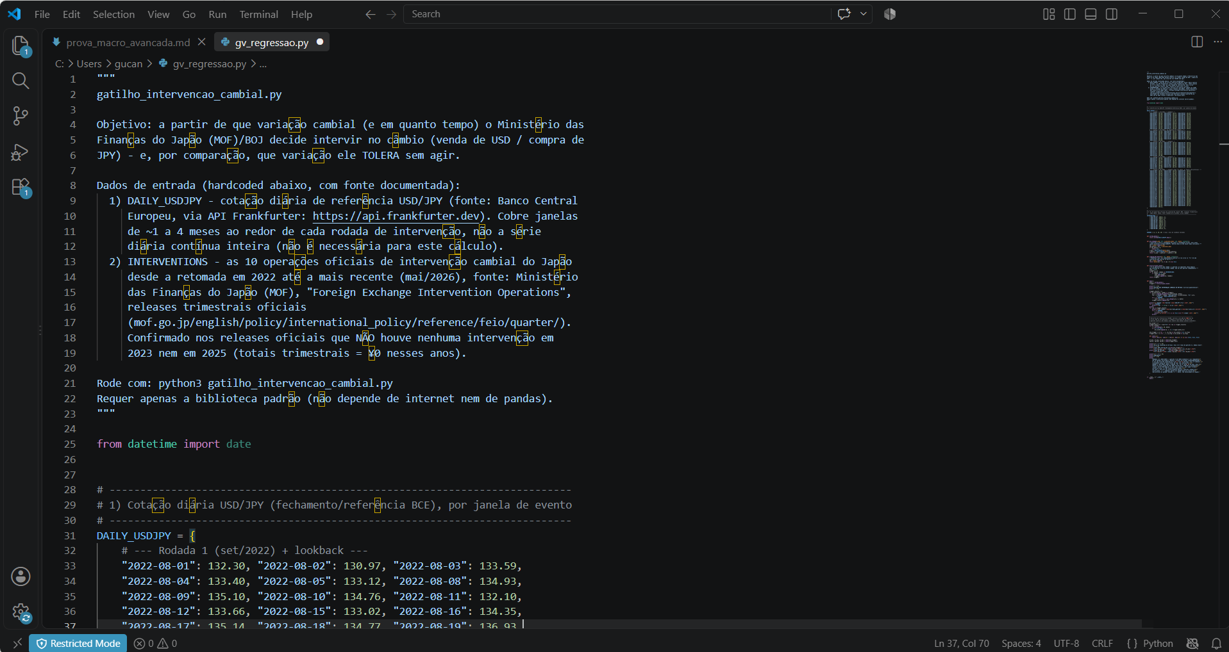
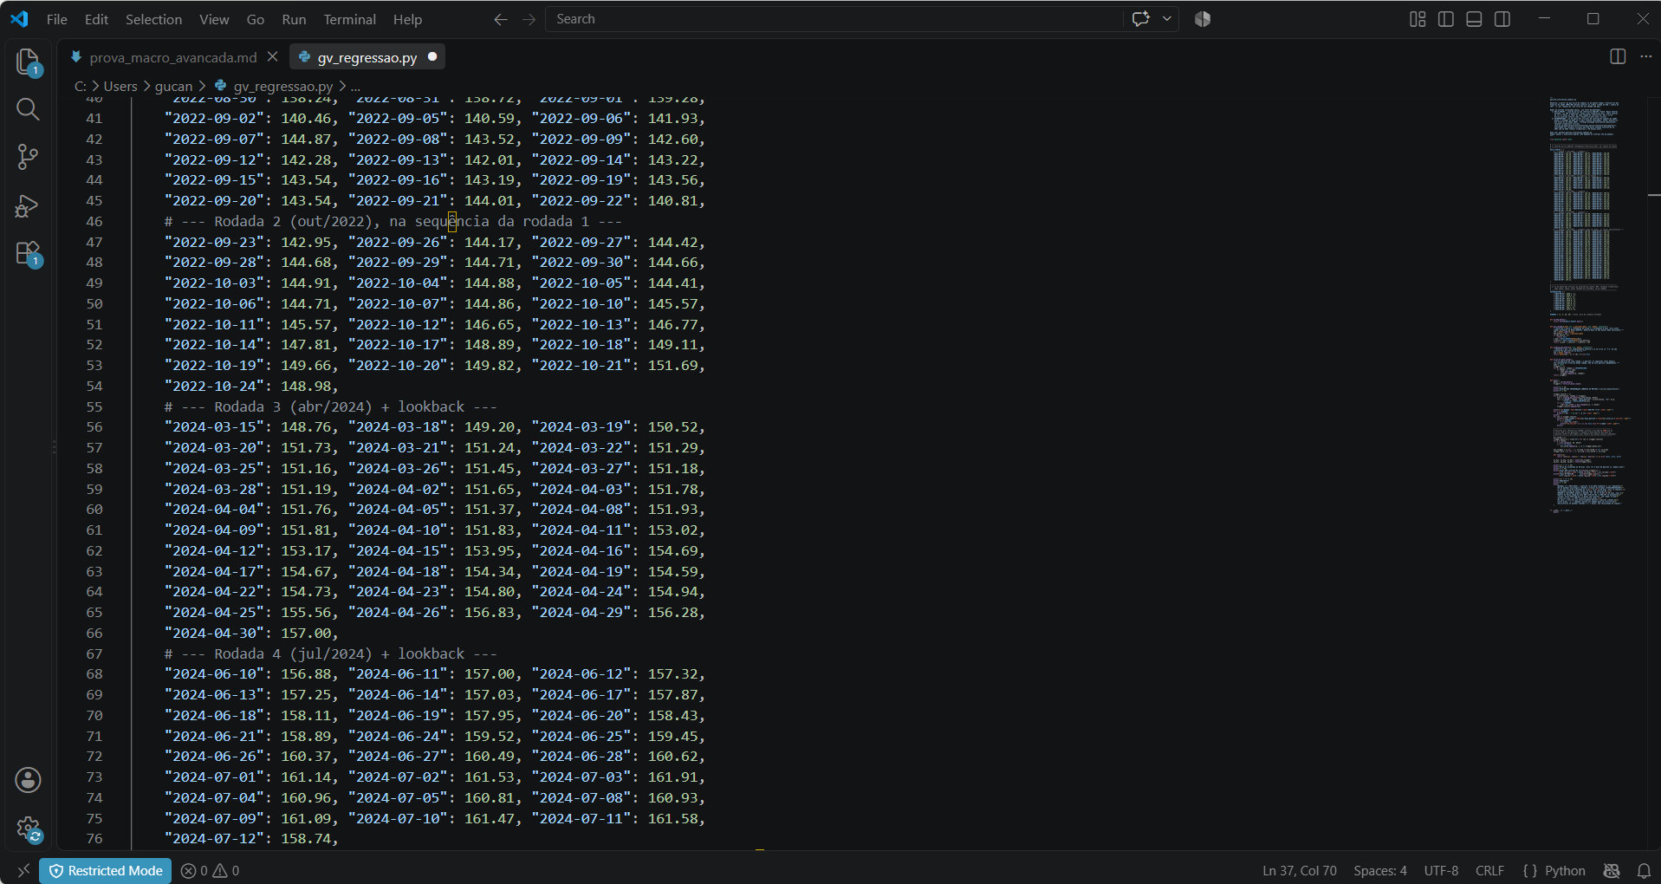

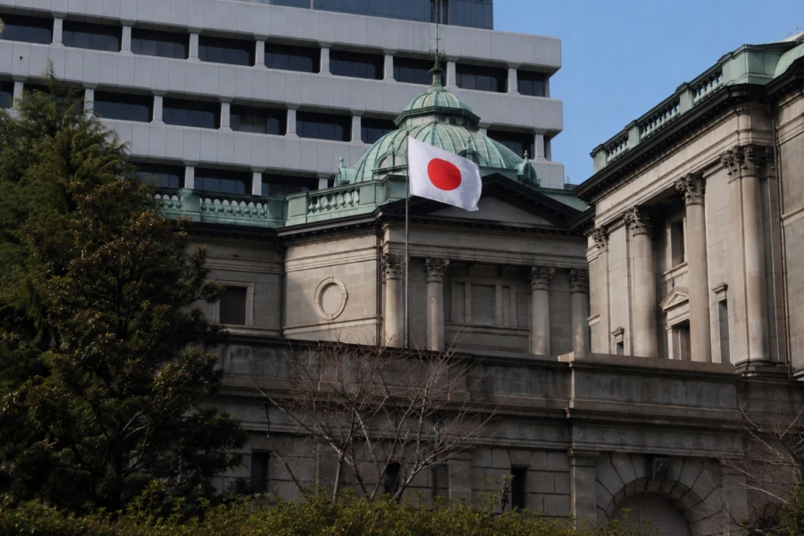

BOJ interventions are typically aimed at curbing the rapid depreciation of the yen
Exchange vs BOJ Foreign Exchange Interventions in USD
Sell: 0,78 Bi
Sell: 3,87 Bi
2022-2024:
The BOJ intervened when the yen depreciated to round-number levels and showed a variation of more than 5% over a 20-week period
Sell: 2,84 Bi
Sell: 2,37 Bi
Sell: 0,73 Bi
2026:
The BOJ intervened without any abrupt moves, but over a four-month period at levels ranging from 153 to 160 JPN/USD
Sell: 4,68 Bi
Sell: 5,92 Bi
Sell: 3,17 Bi
Sell: 6,28 Bi
Sell: 5,62 Bi
The sale of dollars on July 30, 2026, was carried out jointly with the Fed, marking a historic partnership between the two governments

Slide 73
Japan and USA relationship
Japan and the USA are two historic partners
Trump's tariffs reached a peak of 15%, even with the trade deficit
1,18T
of Japan external assets are in American Bons, making then the America greatest creditor
58,2%
of Japan's trade is denominated in dollars
15%
It is the mutual trade tariff agreement established between the two countries.

Slide 74
A long period of trade surplus
Japan has had a significant trade surplus since 1980
Japan faced two structural breaks over the last 36 years
Japan manages to be a creditor to the world
Total exports vs. total imports (M/M, USD bn)
NIIP breakdown (USD bn)
~60%
of External Assets in US Dollars
1.18T
in American Bonds
The United States is Japan’s greatest credor
Sources: BOJ | Trading Economics
Labor market
Economic activity
Inflation
Fiscal scenario
External sector
Monetary policy

Slide 75
Always in surplus on current account
Primary income sustains this surplus since 2010
Foreign prefer financial investments
Undergoes a process of internationalization of the financial system
Breakdown of external liabilities (USD Bn)
External debt breakdown (USD Bn)
Sources: BOJ | Trading Economics
Labor market
Economic activity
Inflation
Fiscal scenario
External sector
Monetary policy

Slide 76
DXJ – ETF que replica empresas exportadoras japonesas
Nikkei 225 vs Cambio, calcular correlação entre ambos (-1)
Foreign Equity Investments
Nikkei 225

Slide 78
A trade balance narrowing over time
Since 1990, Japan's trade balance has been shrinking and becoming volatile
A large part of the deficit stems from China and Australia
An extremely volatile trade balance
Commercial balance with Japan 6 biggest comercial partners and Brazil in USD Bi
Japan exports and imports breakdown and trade terms
Exports
Imports
-52,9
49,9
16,4
-4,1
19,4
2,7
-30,5
Japan comercial trades in 2025
Region of the world | Trade balance (USD bn) | % of the total
America | 46.6 | 20.28%
Europe | -15.2 | 13.55%
Asia/Oceania | -5.0 | 54.59%
Middle East/Africa | -46.0 | 11.58%
Source: BOJ | Trading Economics
Labor market
Economic activity
Inflation
Fiscal scenario
External sector
Monetary policy

Slide 79
A trade balance narrowing over time
Since 1990, Japan's trade balance has been shrinking and becoming volatile
A large part of the deficit stems from China and Australia
An extremely volatile trade balance
Commercial balance with Japan 6 biggest comercial partners and Brazil in USD Bi
Japan exports and imports breakdown and trade terms
Exports
Imports
-52,9
49,9
16,4
-4,1
19,4
2,7
-30,5
Japan's energy self-sufficiency
Source: BOJ | Trading Economics
Labor market
Economic activity
Inflation
Fiscal scenario
External sector
Monetary policy

